Slide 1

The Machine Learning Process
Python 101 – Regular Expressions
Sathish Ravichandran

Slide 2

Regular Expressions (re module)
Regular expressions are text matching patterns described with a formal syntax.

Slide 3
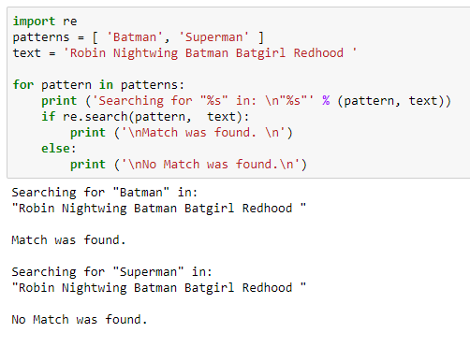
Searching for Patterns in Text
One of the most common uses for the re module is for finding patterns in text.
Notes:
import re
patterns = [ 'Batman', 'Superman' ]
text = 'Robin Nightwing Batman Batgirl Redhood '
for pattern in patterns:
print ('Searching for "%s" in: \n"%s"' % (pattern, text))
if re.search(pattern, text):
print ('\nMatch was found. \n')
else:
print ('\nNo Match was found.\n')

Slide 4
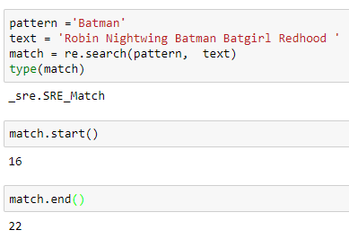
Match object
re.search() will take the pattern, scan the text, and then returns a Match object.
This Match object returned by the search() method is more than just a Boolean or None, it contains information about the match
Notes:
pattern ='Batman'
text = 'Robin Nightwing Batman Batgirl Redhood '
match = re.search(pattern, text)
type(match)
match.start()
match.end()

Slide 5
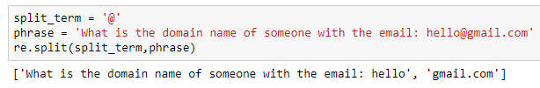
Split with re
re.split() returns a list with the term to spit on removed and the terms in the list are a split up version of the string.
Notes:
split_term = '@'
phrase = 'What is the domain name of someone with the email: hello@gmail.com'
re.split(split_term,phrase)

Slide 6
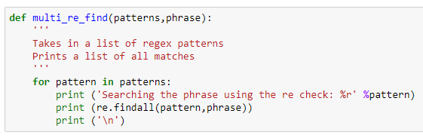
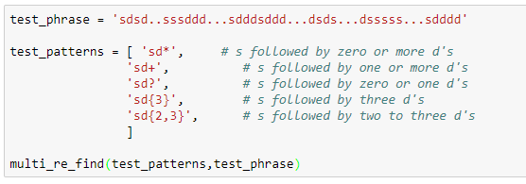
Finding all instances of a pattern
Notes:
def multi_re_find(patterns,phrase):
'''
Takes in a list of regex patterns
Prints a list of all matches
'''
for pattern in patterns:
print ('Searching the phrase using the re check: %r' %pattern)
print (re.findall(pattern,phrase))
print ('\n’)
test_phrase = 'sdsd..sssddd...sdddsddd...dsds...dsssss...sdddd'
test_patterns = [ 'sd*', # s followed by zero or more d's
'sd+', # s followed by one or more d's
'sd?', # s followed by zero or one d's
'sd{3}', # s followed by three d's
'sd{2,3}', # s followed by two to three d's
]
multi_re_find(test_patterns,test_phrase)

Slide 7
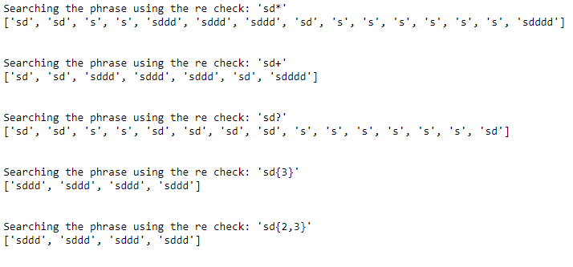
re.findall - output

Slide 8
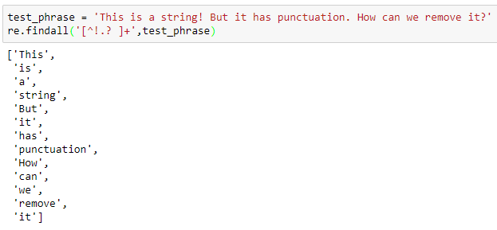
Exclusion
We can use ^ to exclude terms by incorporating it into the bracket syntax notation. For example: [^...] will match any single character not in the brackets.
Notes:
test_phrase = 'This is a string! But it has punctuation. How can we remove it?'
re.findall('[^!.? ]+',test_phrase)

Slide 9
Exclusion
We can use ^ to exclude terms by incorporating it into the bracket syntax notation. For example: [^...] will match any single character not in the brackets.
Notes:
test_phrase = 'This is a string! But it has punctuation. How can we remove it?'
re.findall('[^!.? ]+',test_phrase)

Slide 10
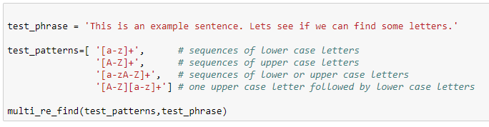
Character Ranges
What is the expected output here?
Notes:
test_phrase = 'This is an example sentence. Lets see if we can find some letters.'
test_patterns=[ '[a-z]+', # sequences of lower case letters
'[A-Z]+', # sequences of upper case letters
'[a-zA-Z]+', # sequences of lower or upper case letters
'[A-Z][a-z]+'] # one upper case letter followed by lower case letters
multi_re_find(test_patterns,test_phrase)

Slide 11
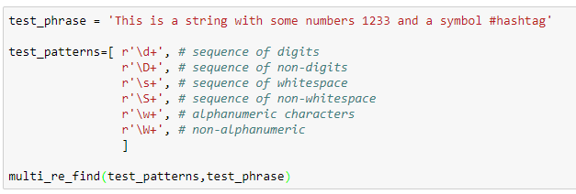
Escape Codes
You can use special escape codes to find specific types of patterns in your data, such as digits, non-digits,whitespace, and more.
Notes:
test_phrase = 'This is a string with some numbers 1233 and a symbol #hashtag'
test_patterns=[ r'\d+', # sequence of digits
r'\D+', # sequence of non-digits
r'\s+', # sequence of whitespace
r'\S+', # sequence of non-whitespace
r'\w+', # alphanumeric characters
r'\W+', # non-alphanumeric
]
multi_re_find(test_patterns,test_phrase)

Slide 12
Thank you
The Capacity to learn is a gift;
The ability to learn is a skill;
The willingness to learn is a choice.
-Brian Herbert

